Slide 1
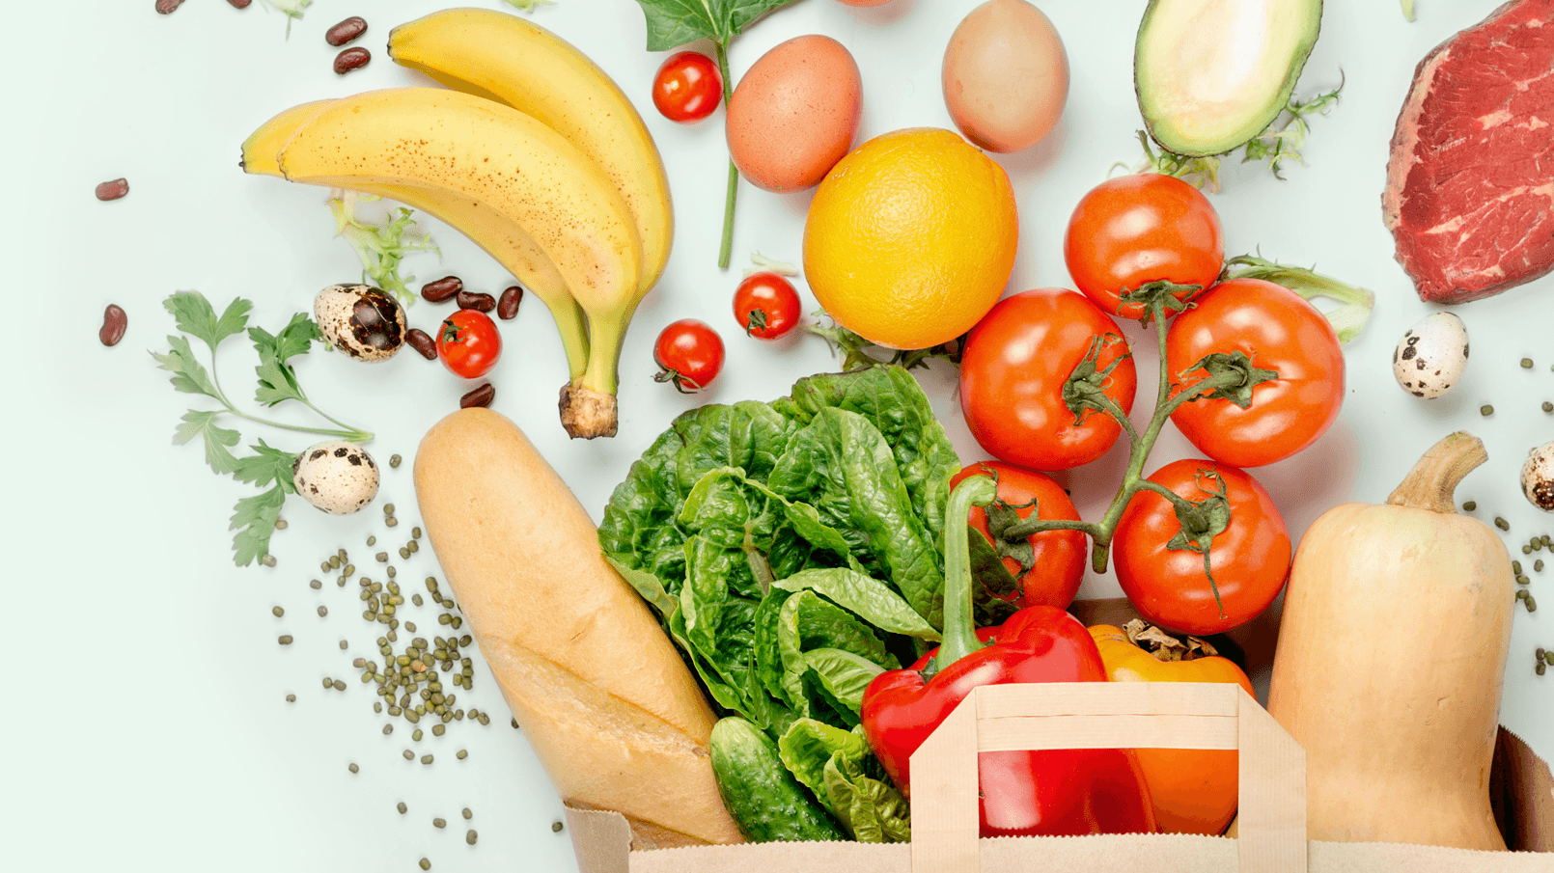
Food Vision
Convolutional Neural Network

Slide 2
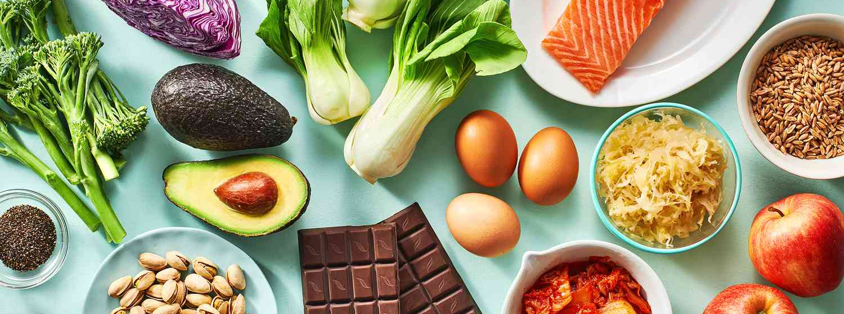
Food101 Dataset
Image dataset used for food recognition tasks
101 food categories
Each category contains 1,000 images

Slide 3
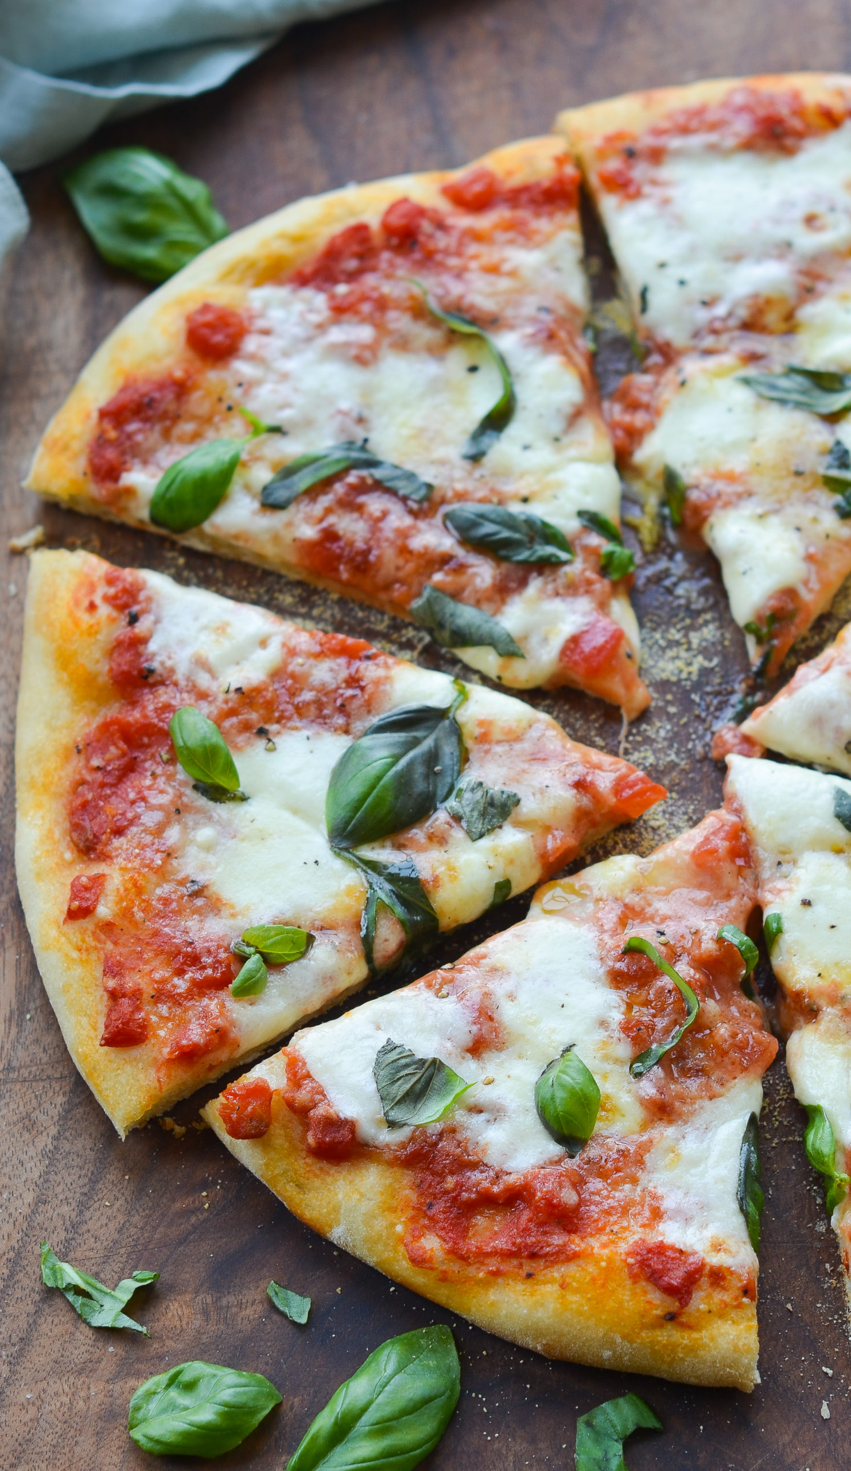
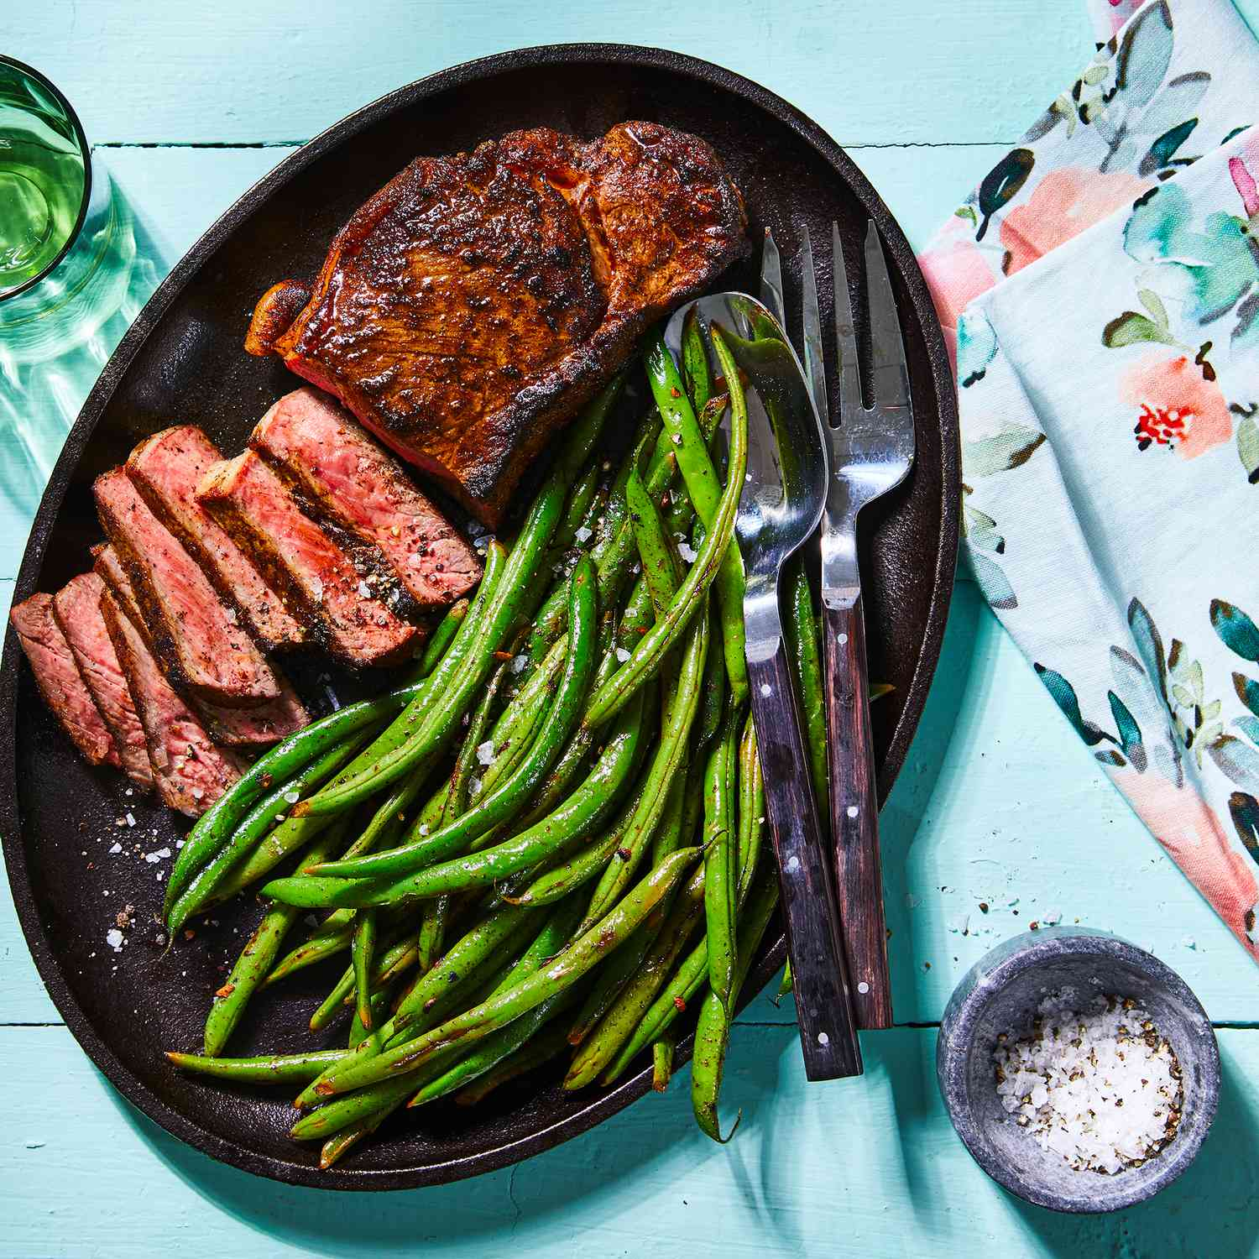
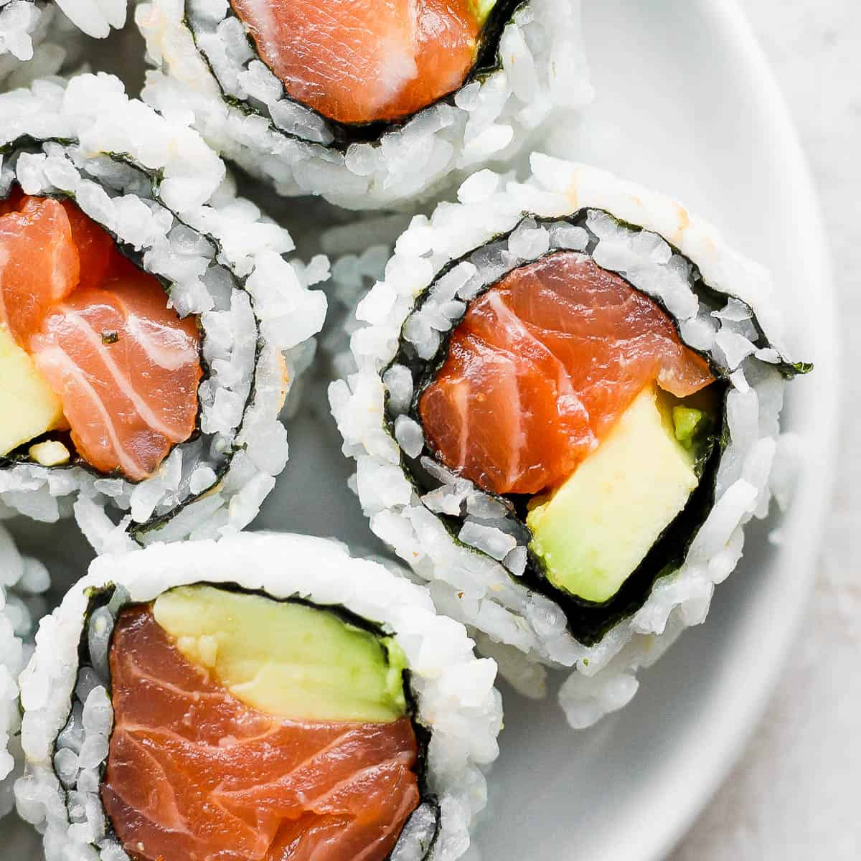
Custom Food3 Dataset
Contains 3 classes
1000 items per class

Slide 4
Convolutional Neural Network

Slide 5
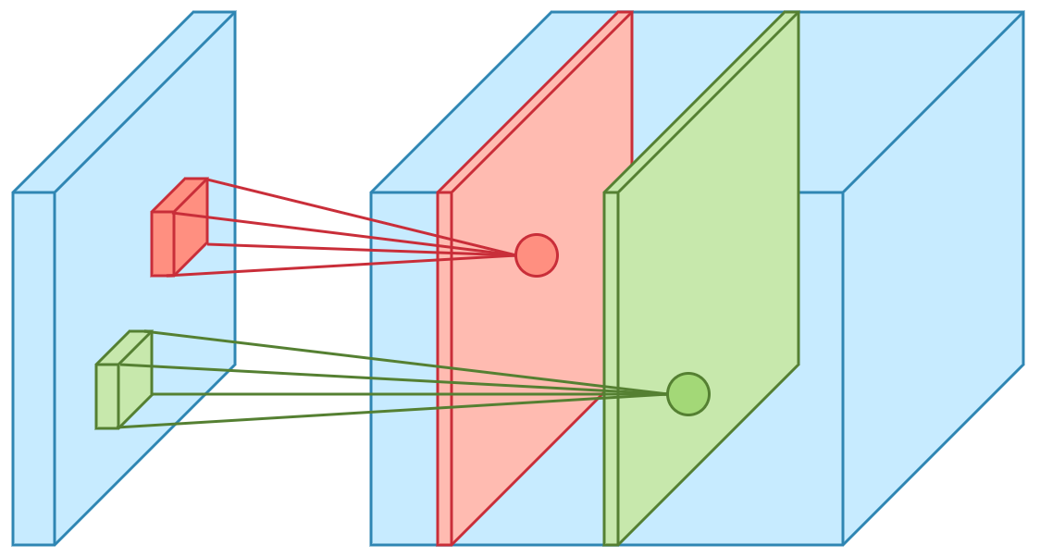
CNN Basic Architecture
Convolutional Layer
ReLU Activation
MaxPool layer

Slide 6
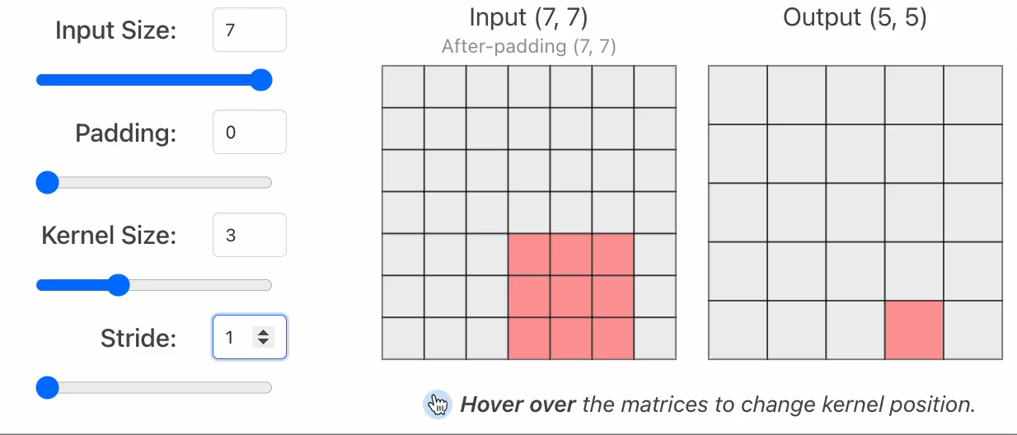
Convolutional Layer: Kernel

Slide 7
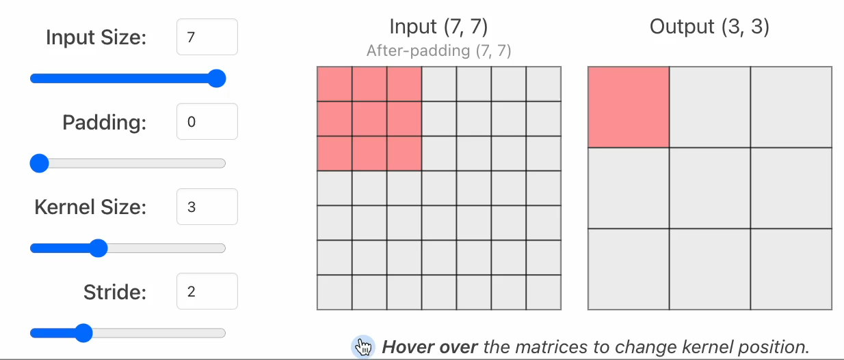
Convolutional Layer: Stride

Slide 8
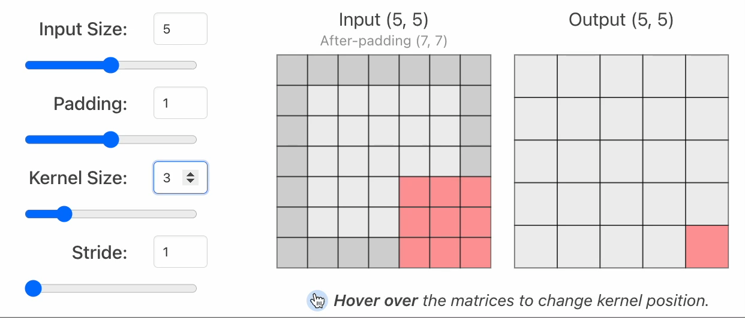
Convolutional Layer: Padding

Slide 9
Convolutional Layer in Action

Slide 10
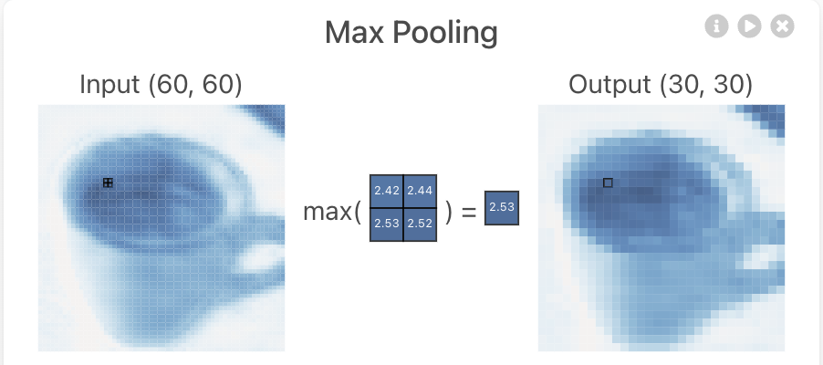
Convolutional Layer: MaxPool

Slide 11
TinyVGG Architecture
Convolutional Block 1:
Convolutional Layer
ReLU Activation
Convolutional Layer
ReLU Activation
Convolutional Block 2
Convolutional Layer
ReLU Activation
Convolutional Layer
ReLU Activation
Classifier
Flatten Layer
Linear Layer
MaxPool Layer
MaxPool Layer

Slide 12
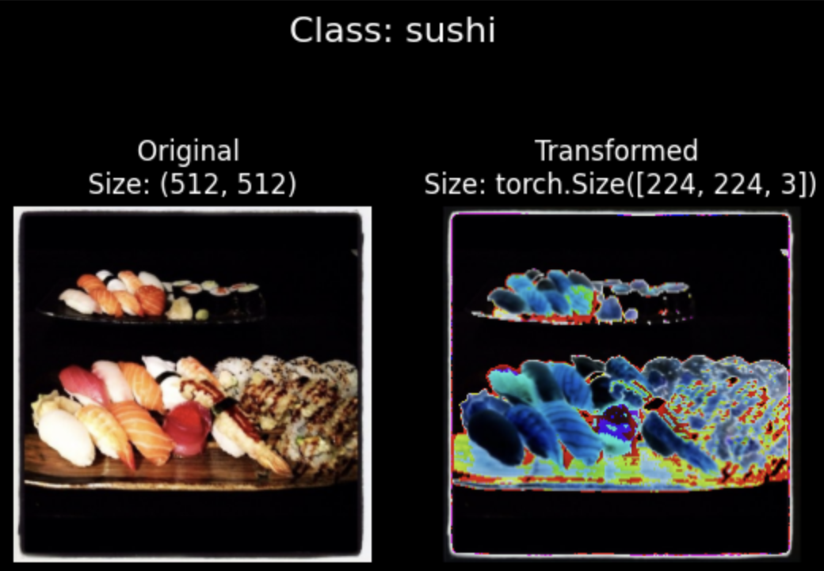
Data Augmentation

Slide 13
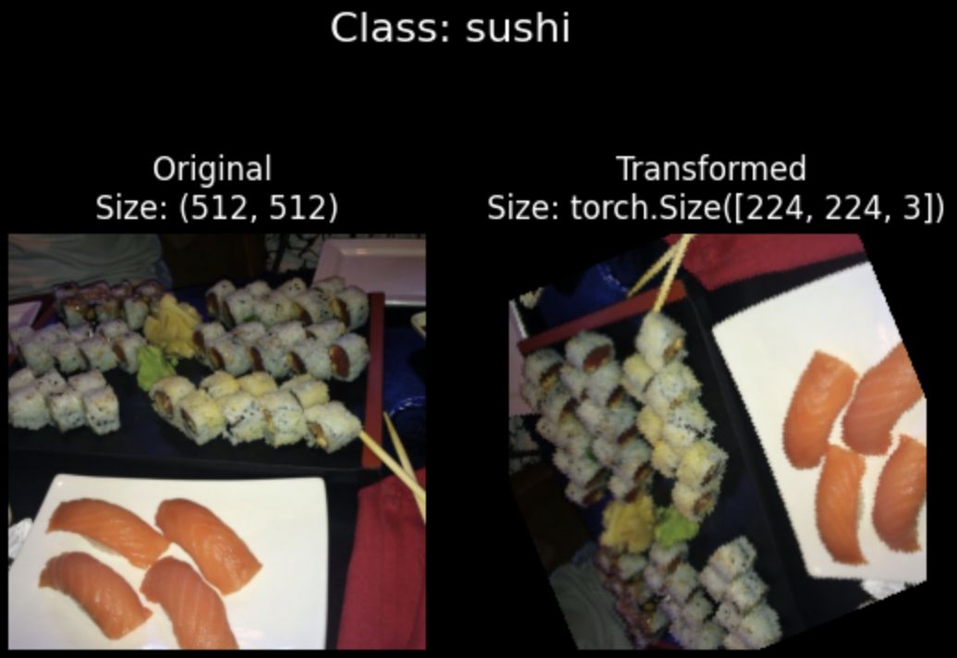
Data Augmentation

Slide 14
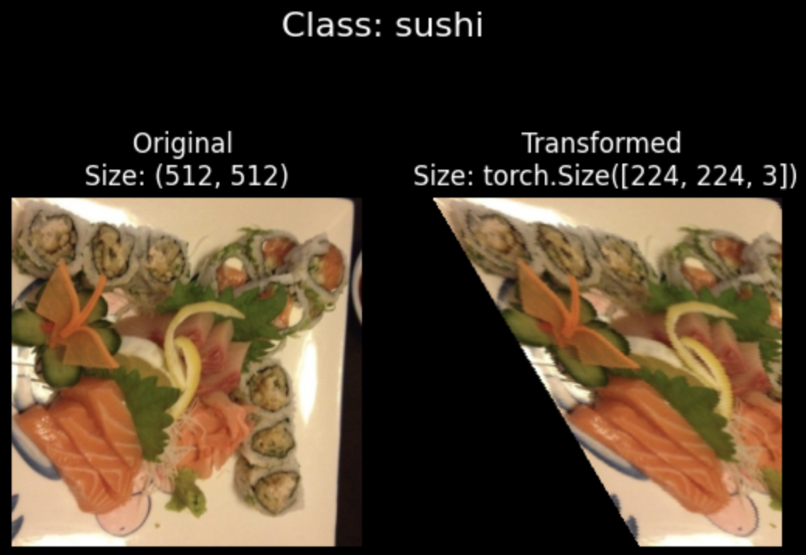
Data Augmentation

Slide 15
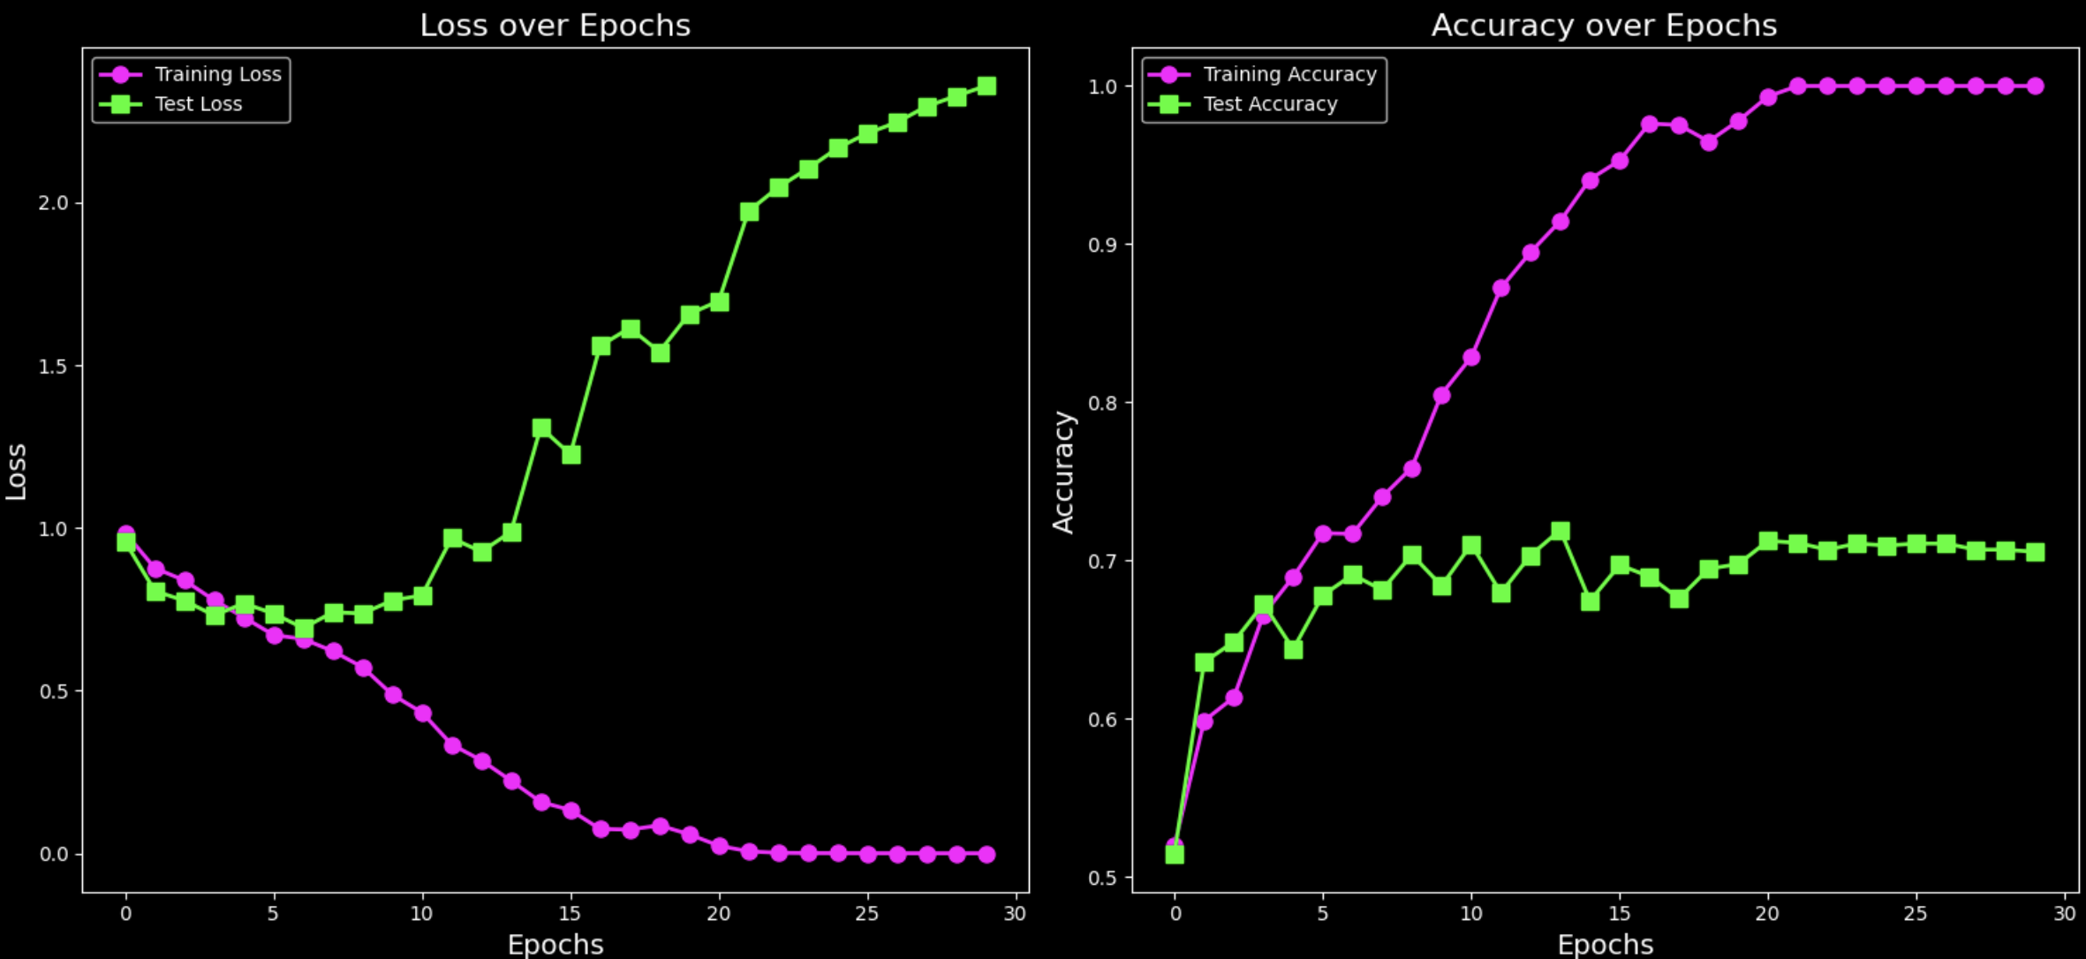
Model 0: Without Data Augmentation

Slide 16
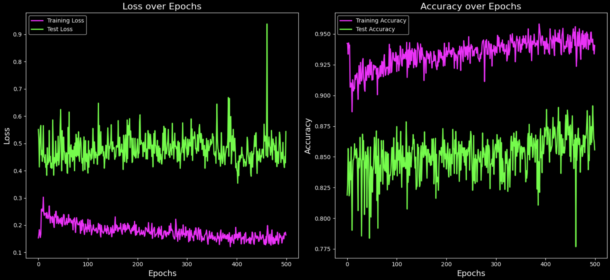
Model 1: With Data Augmentation

Slide 17
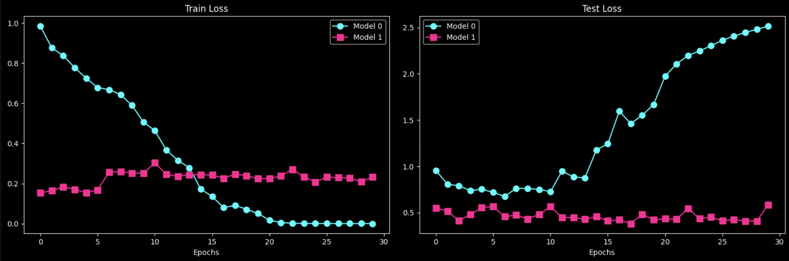
Model 0 vs Model 1: Loss curves

Slide 18
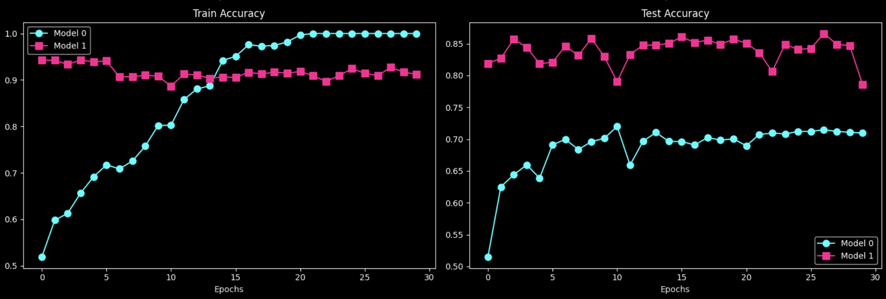
Model 0 vs Model 1: Accuracy

Slide 19
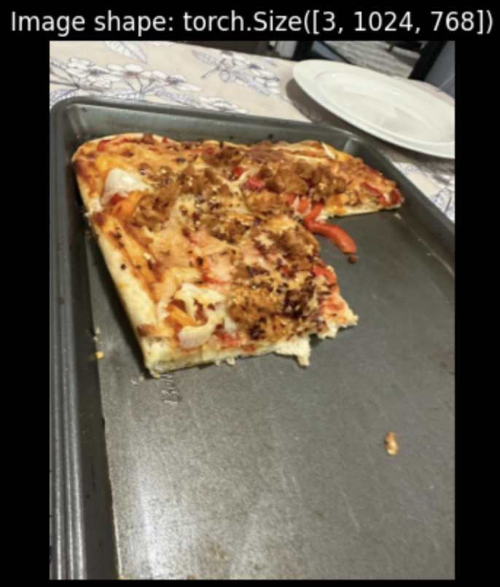
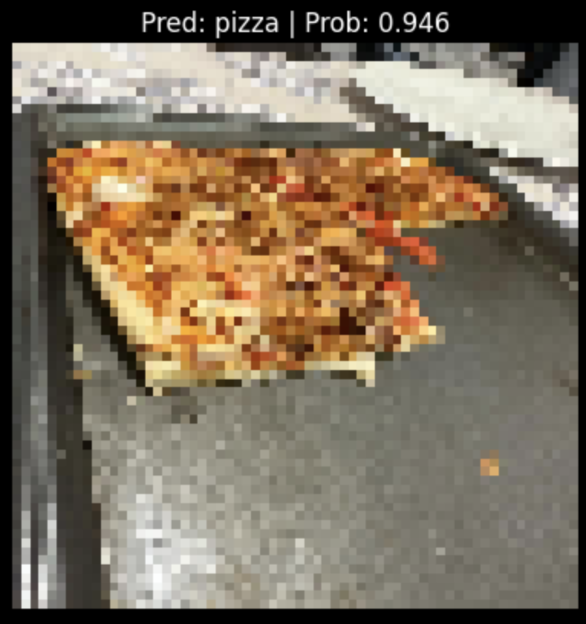
Predicting on custom image

Slide 20

Thank You!

